Slide 1
Agile Data Platform
Introduction to testing

Slide 2
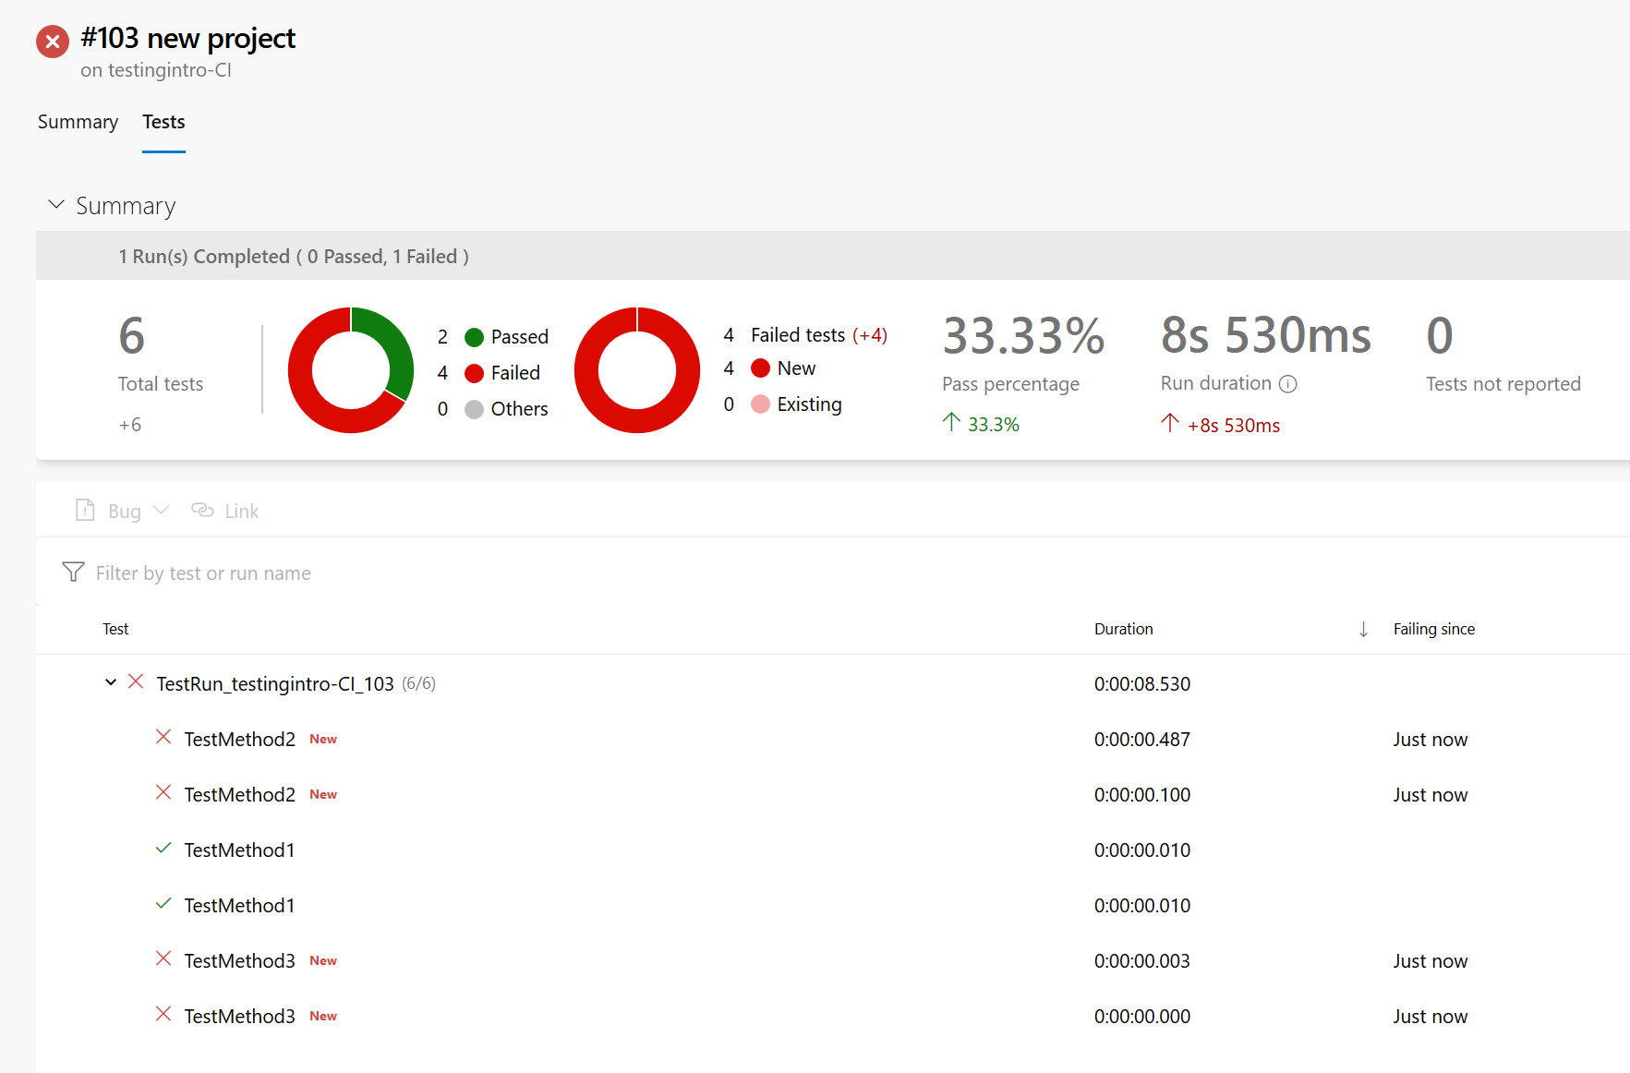
Why Test?
Quality
Prevent degradation
Set gates on release processes
Confidence
Repeatability
Works first time every time
Security
Spot unauthorised changes

Slide 3
Choosing a Framework
MS Test Framework (CSharp etc.)
Complex requirements
Functions, Web code
Pester (PowerShell)
Infrastructure, databases
PyTest (Python)
Databricks
There are many, many more

Slide 4
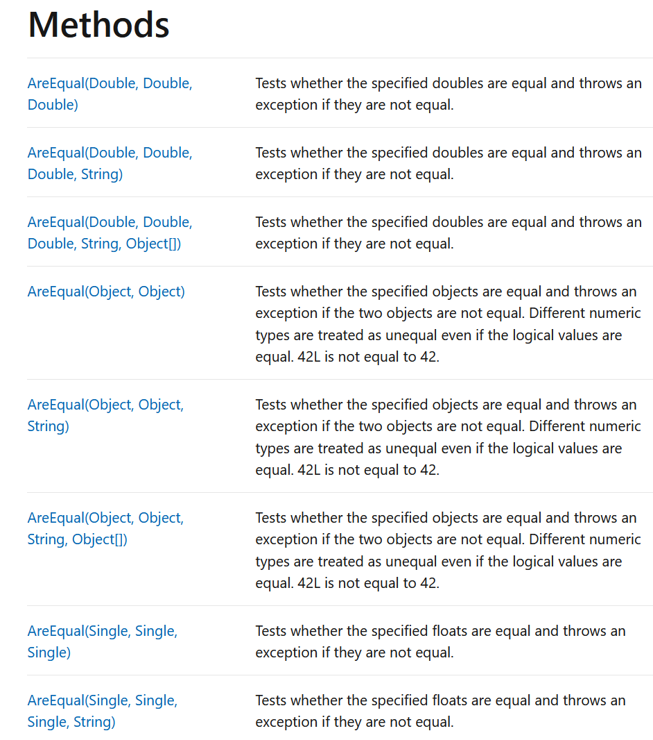
Using a Framework
Assert
State what you’re expecting
Even if that’s an error
If the result matches expectations it’s a pass
Examples
Assert that inserting a string into an Int column should return an error
Assert that an add function will return 3 if it has 1 and 2 as parameters
Assert that an add function should return an error if I ask it to add “cat” and 7
Assert that a PK column have type GUID, if the developer changes to Int we get a fail

Slide 5
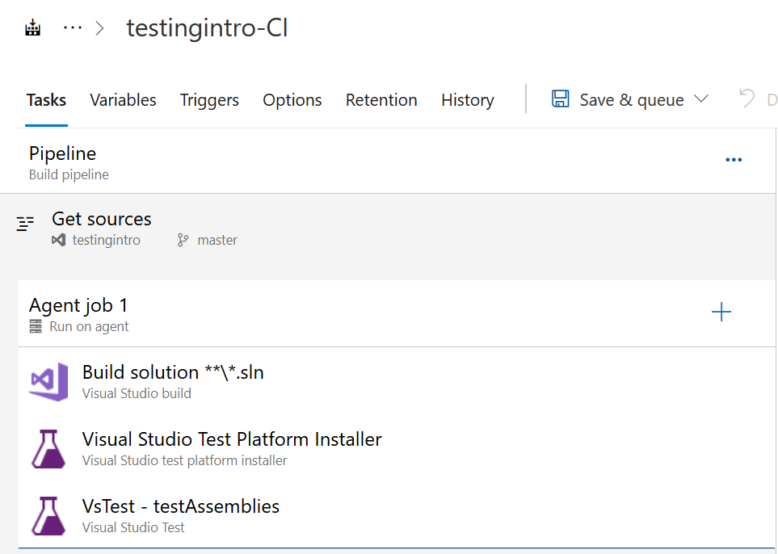
Integration with Azure DevOps
Support for various frameworks
Generic XML for MSTest v2, NUnit, and xUnit
Dedicated tasks for e.g. VSTest
Generic results import for e.g. PyTest XML
Tests run either on agent or remote
Remote testing can be imported as file
Network access can be a consideration

Slide 6
Types of test
Engineering Testing (Pre-deployment)
Unit Tests
Unit vs integration
Automatic vs manual
Performance/capacity vs functional
Data testing
Quality
Processing success
Consistency
Integration Tests
Performance and Scale Tests
Operational Testing (runtime)
Pipeline Monitoring
Data Quality Tests
Performance and Scale Tests

Slide 7
Test Data
Generate known good test data
Start with the test and work backwards to data
Generate only enough to perform tests
Test data is static
Stored in the repo and/or in a dedicated test location
Performance Testing
Known size representative data sets can be used for performance checking
Actual live data can be used for performance against current production
Ephemeral environment for parallel processing

Slide 8
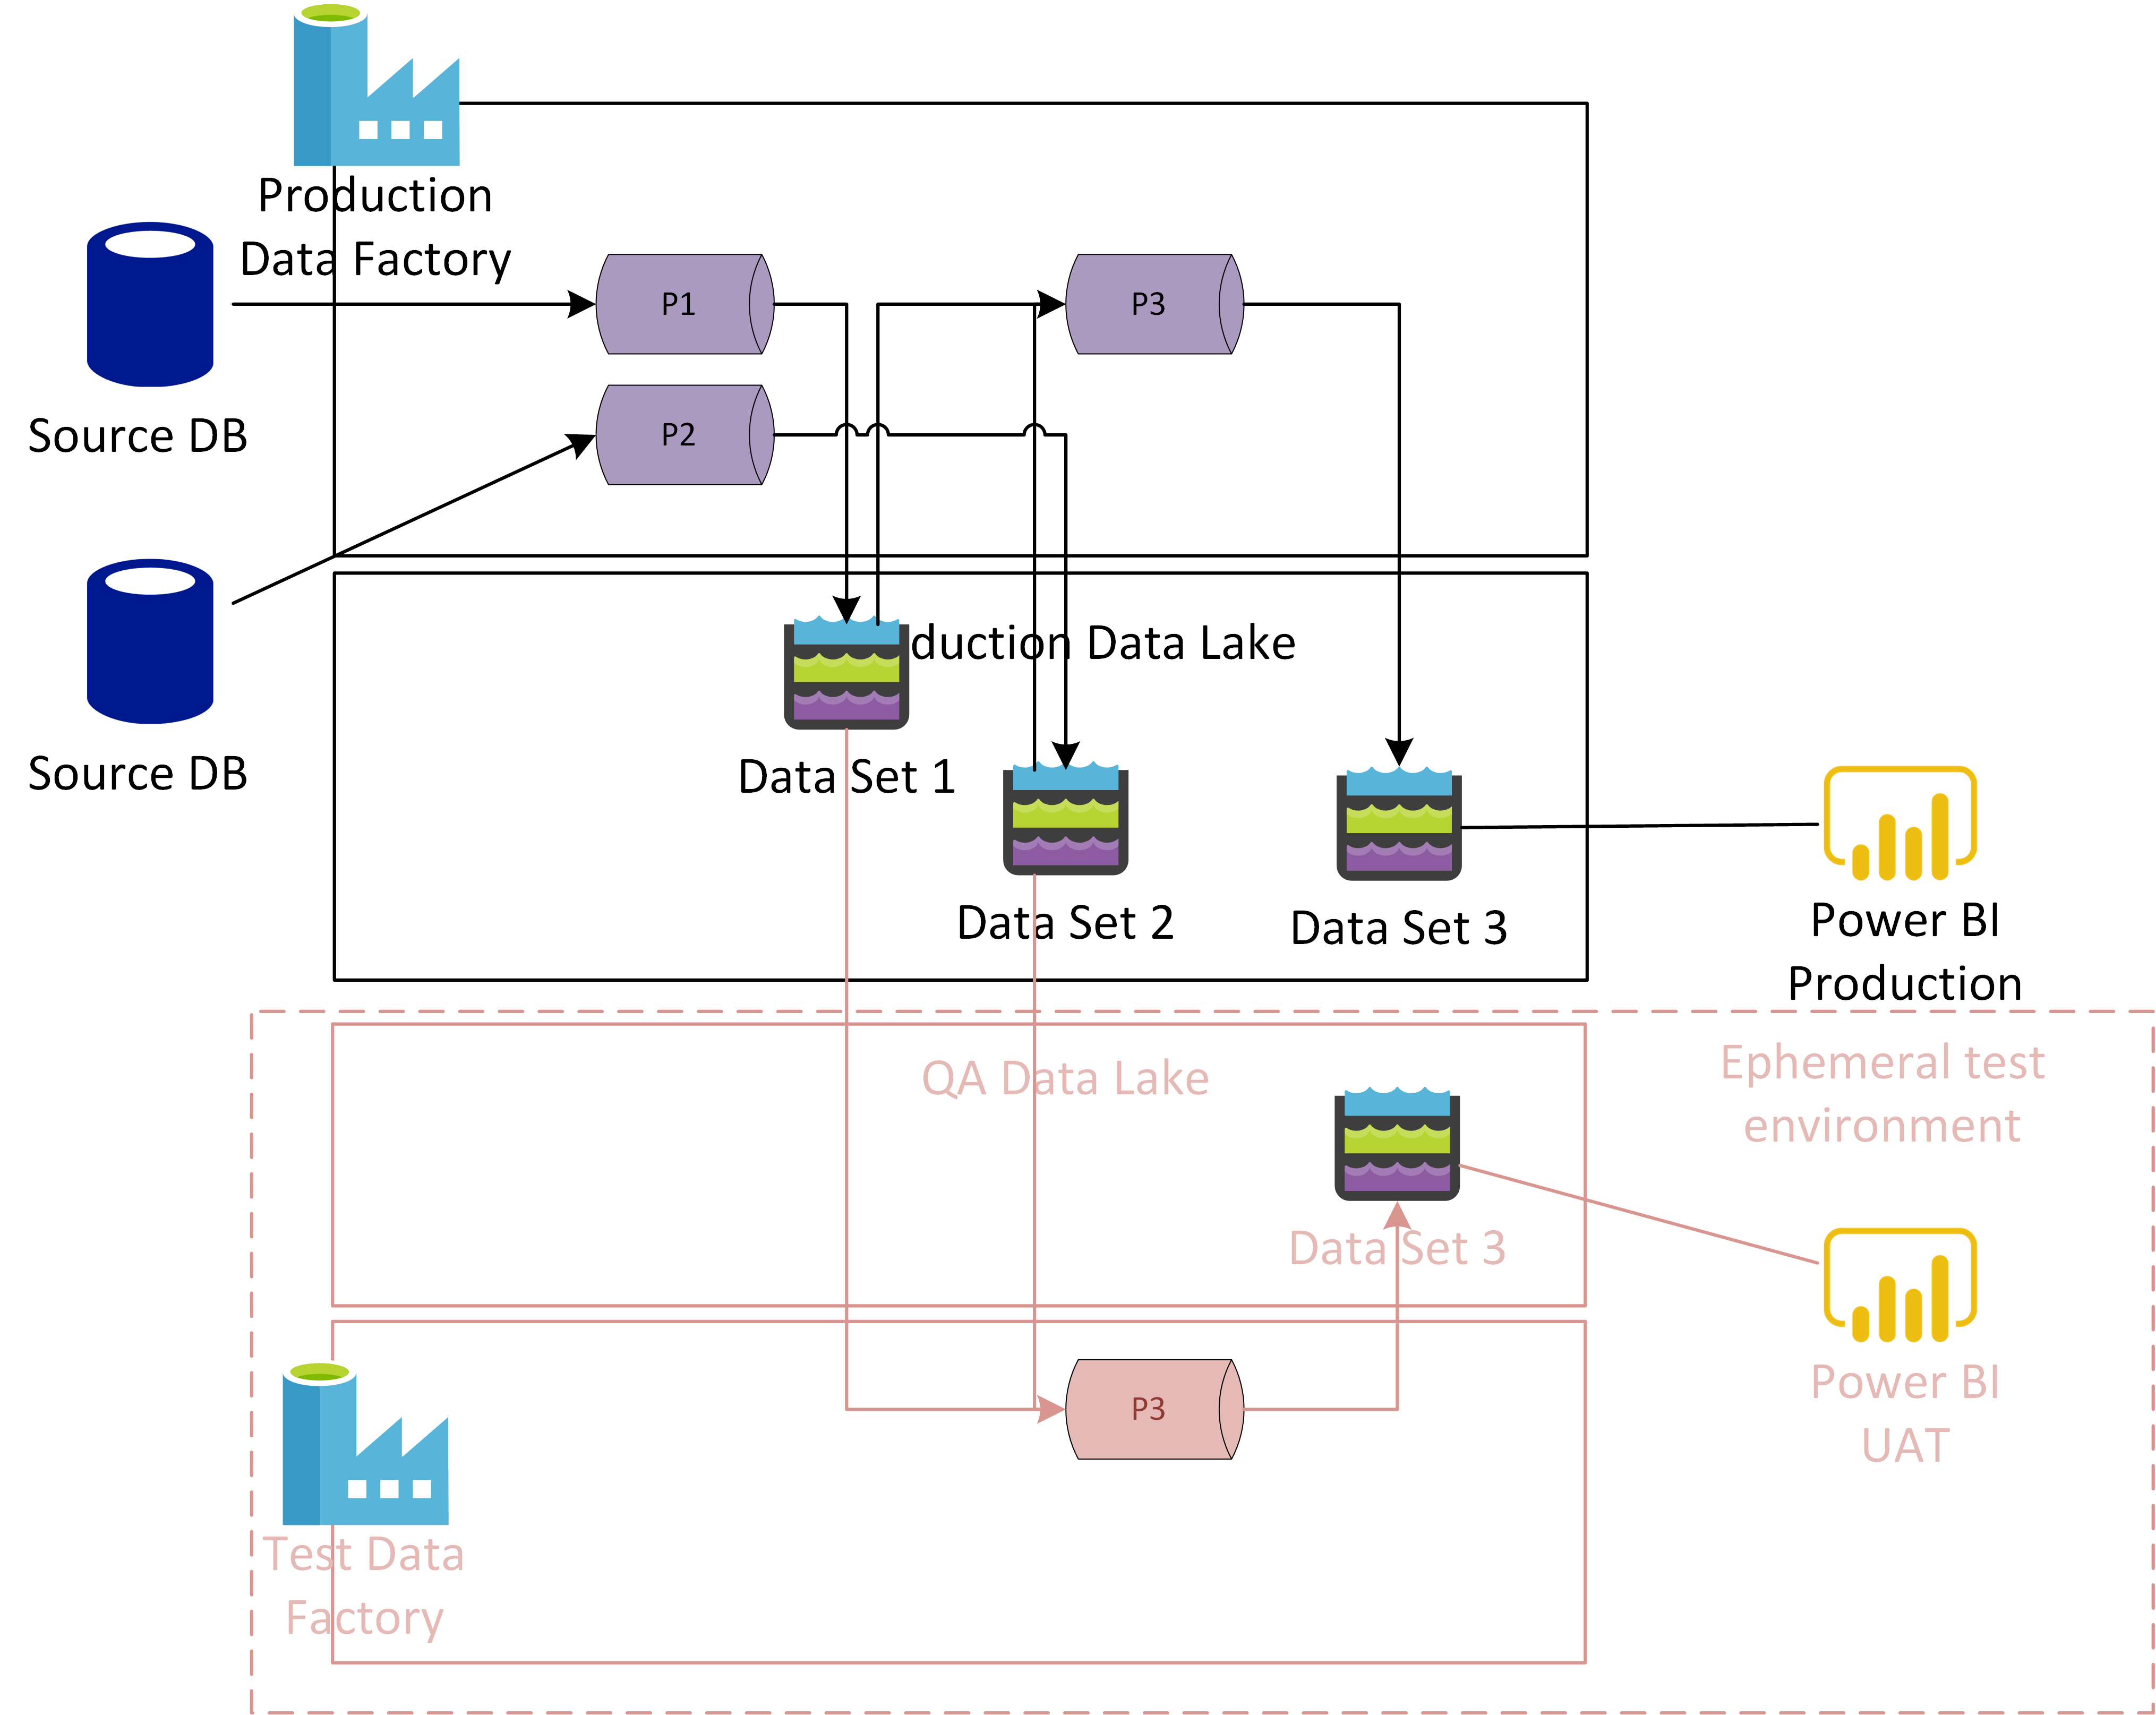
Ephemeral environments
Spin up new environment
UAT testers can point to new endpoint
Performance benchmarks run with standard data set
Multiple SKU sizes can be tried out
Cluster sizes can be tested

Slide 9
What to test?
EVERYTHING
But…
Data quality tests – should the pipeline fail or should bad data be allowed through for data quality checks to catch? Ideally test for things which break deployment

Slide 10
Test Areas
Dates
Data Types
Schema
Infrastructure deployment success
Pipeline speed/capacity

Slide 11
Data Tests - Aggregations
Test your aggregations
Known good data
Known bad data
Known time ranges
Below, the expected value for total sales is 65
Date | Time | Quantity | Valid? | Included in daily Aggregate?
26/03/2022 | 23:59 | 1 | Yes | No
27/03/2022 | 00:00 | 2 | Yes | Yes
27/03/2022 | 00:01 | 6 | Yes | Yes
27/03/2022 | 00:59 | 43 | Yes | Yes
27/03/2022 | 01:30 | 2 | No, clock change | No
27/03/2022 | 02:00 | 6 | Yes | Yes
27/03/2022 | 02:01 | 8 | Yes | Yes

Slide 12
Date Tests – Validity and Format
Transaction Date Value | Region | Date Valid? | Format Valid? | Valid Value?
01/01/2021 | UK | Yes | Yes | Yes
13/01/2021 | UK | Yes | Yes | Yes
13/01/2021 | US | Unknown | No | No
2022-02-02T10:19:44Z | UK | Yes | Yes | Yes
2022-02-29T10:19:44Z | UK | No | Yes | No
01/01/1721 | UK | Yes | Yes | No
01/01/2121 | UK | Yes | Yes | No
31/13/2021 | UK | No | Yes | No
3rd March 2021 | UK | Yes | No | Yes

Slide 13
Date Tests - Daylight Savings (UK)
In March an hour of “till time” disappears
What happens if you record a time of 01:30 “at the till”
In October an hour of “till time” repeats
What happens if you record a transaction at 00:30 UTC and at 01:30 UTC?
Run tests for every region you will process for
Last Sunday in March | UTC | Last Sunday in October
00:58 | 00:58 | 01:58
00:59 | 00:59 | 01:59
02:00 | 01:00 | 01:00
02:01 | 01:01 | 01:01

Slide 14
Date Tests - Daylight Savings (EU)
In March an hour of “till time” disappears
What happens if you record a time of 01:30 “at the till”
In October an hour of “till time” repeats
What happens if you record a transaction at 00:30 UTC and at 01:30 UTC?
Run tests for every region you will process for
Last Sunday in March |  |  | UTC | Last Sunday in October
WET | CET | EET | UTC | WET | CET | EET
00:58 | 01:58 | 02:58 | 00:58 | 01:58 | 02:58 | 03:58
00:59 | 01:59 | 02:59 | 00:59 | 01:59 | 02:59 | 03:59
02:00 | 03:00 | 04:00 | 01:00 | 01:00 | 02:00 | 03:00
02:01 | 03:01 | 04:01 | 01:01 | 01:01 | 02:01 | 03:01

Slide 15
Date Tests - Daylight Savings (US)
In March an hour of “till time” disappears
What happens if you record a time of 01:30 “at the till”
In October an hour of “till time” repeats
What happens if you record a transaction at 00:30 UTC and at 01:30 UTC?
Run tests for every region you will process for
Second Sunday in March | US Standard Time | First Sunday in November
01:58 | 01:58 | 01:58
01:59 | 01:59 | 01:59
03:00 | 02:00 | 01:00
03:01 | 02:01 | 01:01

Slide 16
Date Tests - Leap Year
Every 4 years we count an extra day
What happens if a transaction is recorded on 29th February in a normal year?
What happens when a transaction is recorded on 29th February in a leap year?
Check every single stage of your data pipeline
Date | Valid?
29/02/2022 | No
29/02/2023 | No
29/02/2024 | Yes
29/02/2025 | No

Slide 17
Database Tests - Schema
Check every column and value
Data Definition Language | Test | Expected Result | Result
create table customers( | Does table “customers” exist? | Yes | Pass
PersonID int, | Is the primary key a GUID? | Yes | Fail
LastName varchar(255), | Is LastName a varchar? | Yes | Pass
 | Can I insert the last name Wolfeschlegelsteinhausenbergerdorff? | Yes | Pass
 | Does LastName column exist? | Yes | Pass
Age TinyInt | Does TinyInt column exist? | Yes | Pass
 | Can I insert the word “Integer”? | No | Pass
 | Can I insert the value 28? | Yes | Pass
); | Did the query complete? | Yes | Pass

Slide 18
Library Tests - Code
Check every function
Inputs
Outputs
Functionality
Function | Tests | Expected Result | Result
Int addNumbers (int A, int B) { return (A + B) } | addNumbers(1, ten) | Return generic error | Pass
 | addNumbers(1, 2) | 3 | Pass
 | addNumbers(1) | Return generic error | Pass
 | addNumbers(1, 2, 3) | Return generic error | Pass

Slide 19
Library Tests - Complex
External lookup for customer ID
Test real customer
Test fake customer
Test bad customer ID
Test good customer ID
Test string input
Test integer input

Slide 20
Infrastructure Tests
Does component exist?
Network connectivity?
Firewall rules in place?
Naming correct?
Sized correctly?
Correct Region?
Azure Databricks
Azure Data Factory
Azure Blob Storage
Azure SQL Data Warehouse
Azure Analysis Services
Power BI

